Slide 1
Stratosphere temperature (lagged)
ESN
RMSE Stratosphere temperature (forecasted)
Aerosol optical depth (lagged)
same model
compare
Stratosphere temperature (lagged)
RMSE
Stratosphere temperature (forecasted) with AOD adjusted
ESN
“Adjusted” Aerosol optical depth (lagged)

Slide 2
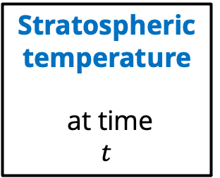
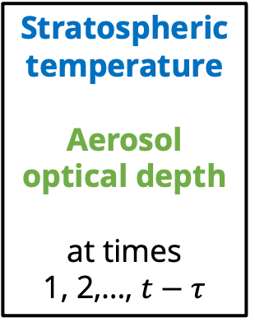
Stratospheric temperature
Aerosol optical depth
at times
1, 2,…, $t−τ$
Stratospheric temperature
at time
$$t$$
Echo State Network

Slide 3
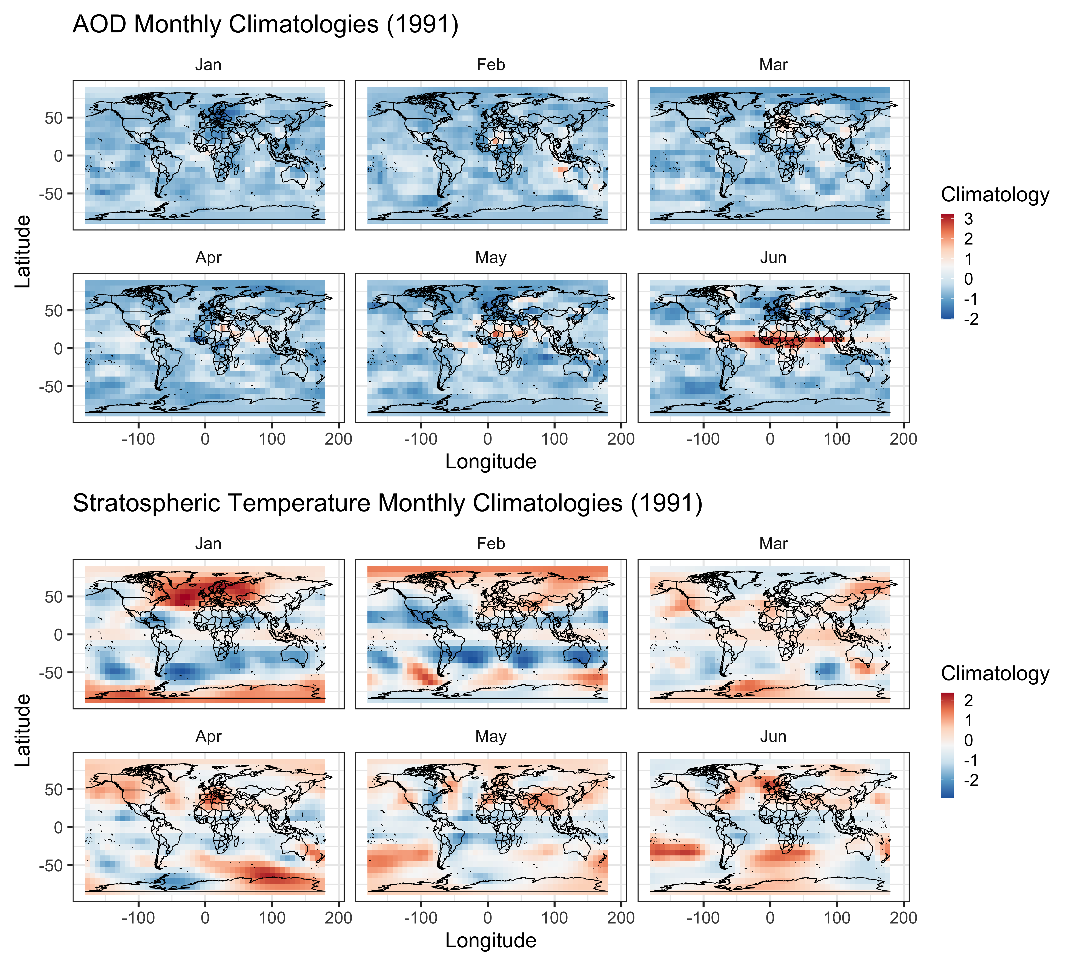
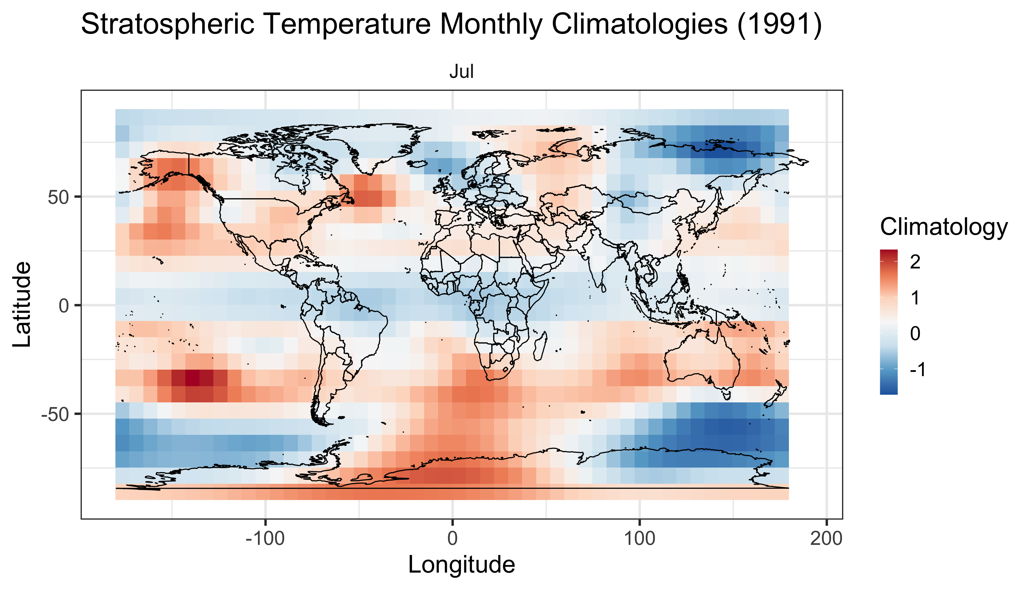
Echo State Network

